Slide 1
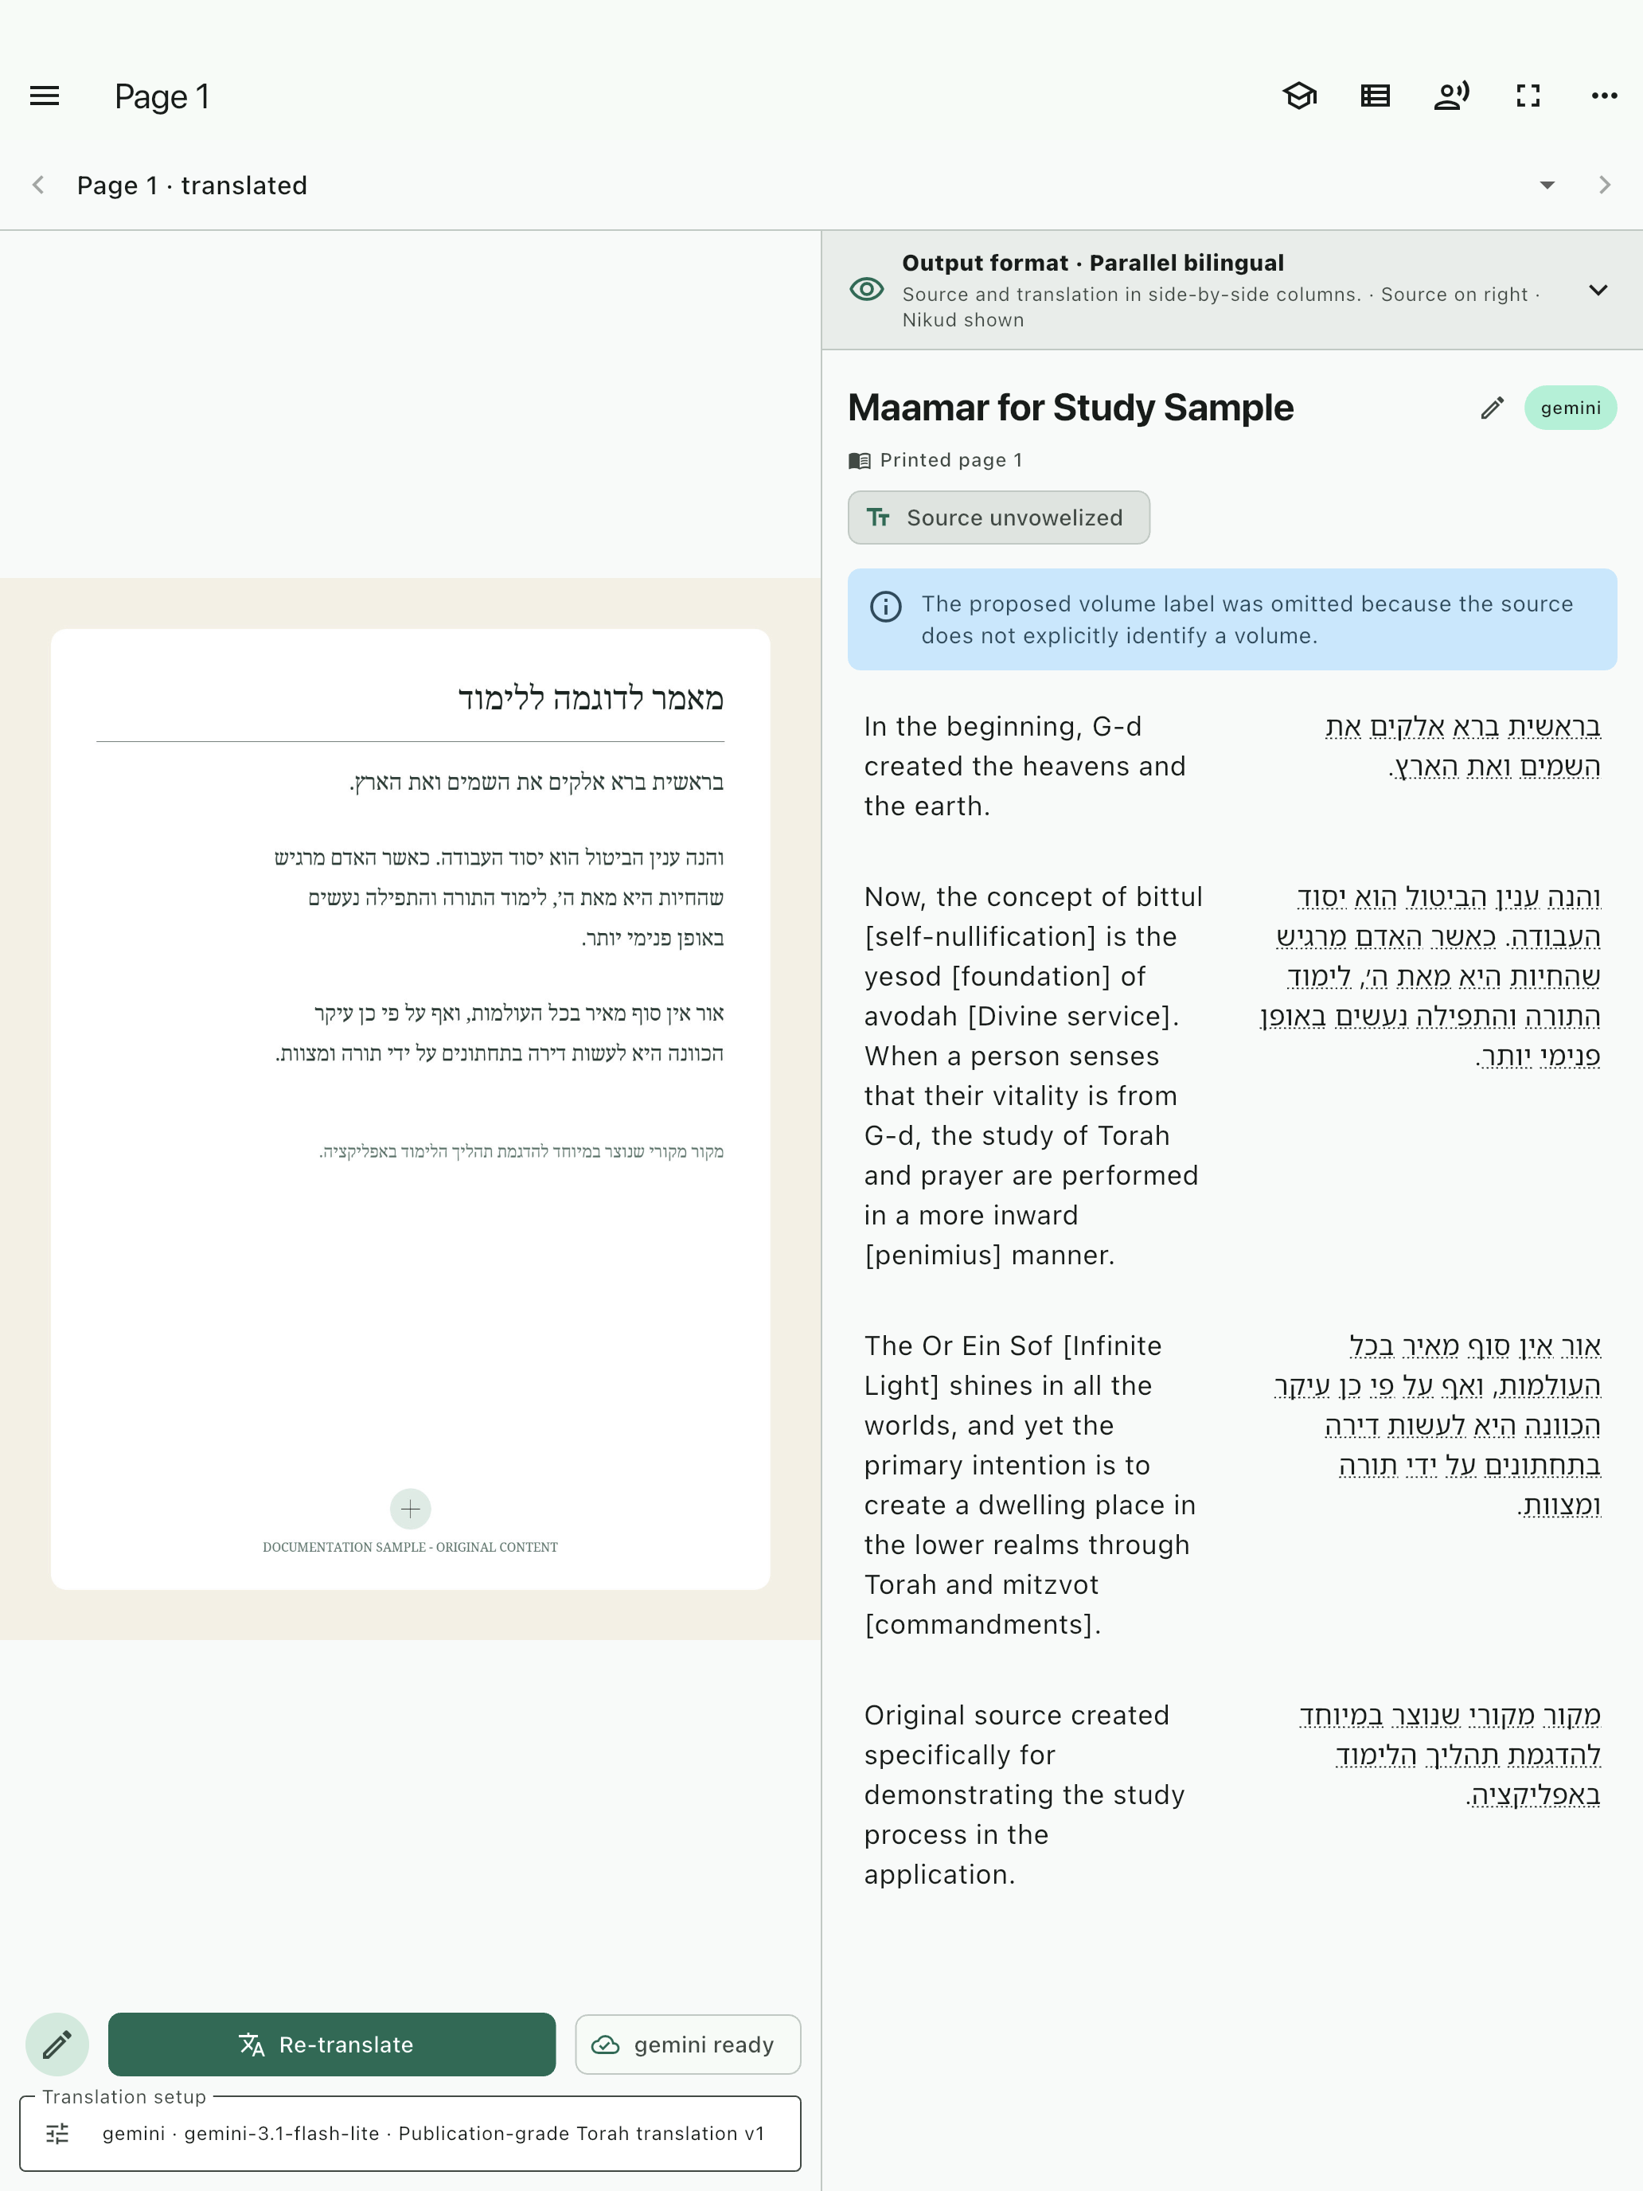
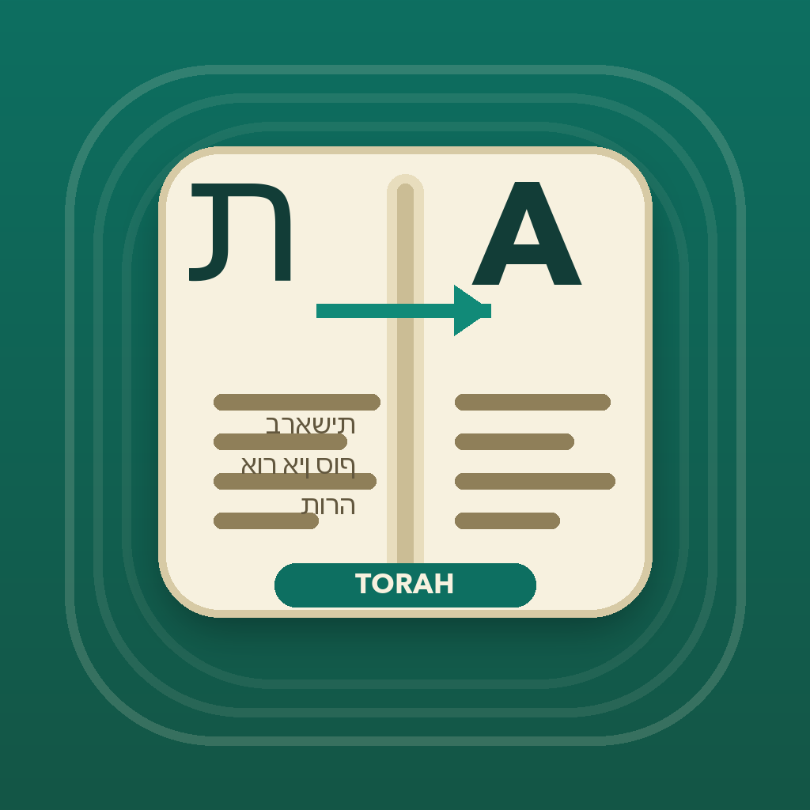
Torah and Chassidus
Translate
Keep the source in view, and make the next question possible.
A source-centered workspace for scanned Hebrew and Yiddish texts
AI output requires review. Provider charges and terms may apply.

Slide 2
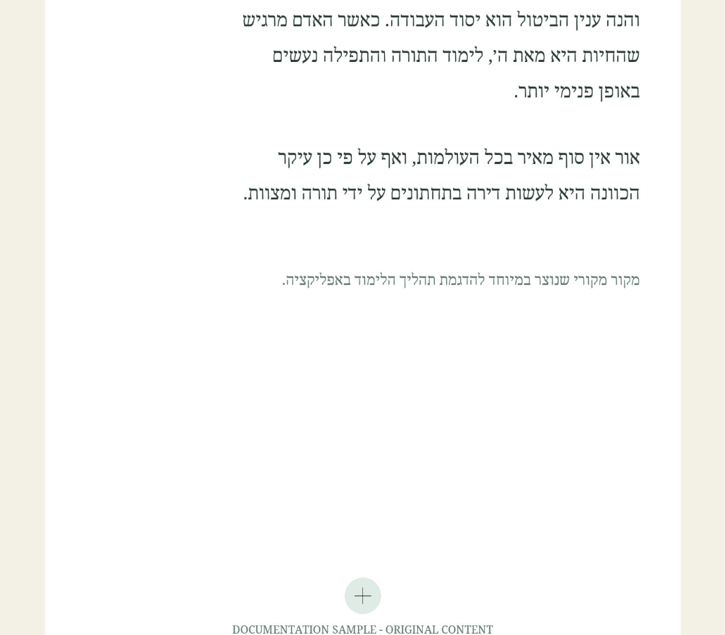
WHY THIS MATTERS
A difficult page creates a practical learning barrier
The page should remain visible—not disappear behind generated prose.
Dense print or unfamiliar language slows the first useful question.
A translation is easier to trust when it can be checked against the source.
The goal is supported study, not automatic authority.
Torah and Chassidus Translate • Authenticated product walkthrough • AI output requires review
02

Slide 3
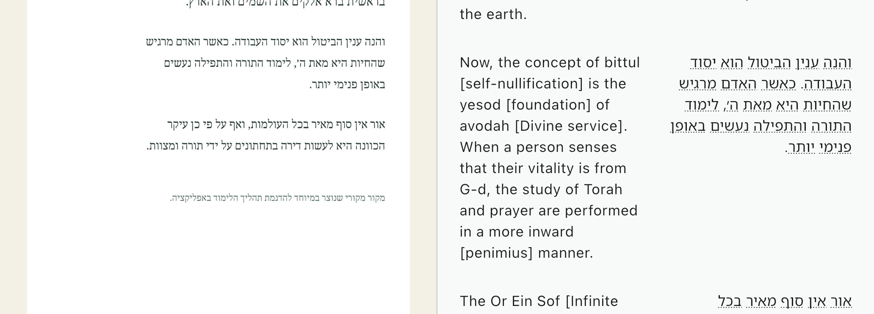
PRODUCT PRINCIPLE
The source remains beside every first-pass translation
Original page → editable source → structured translation → human review
Torah and Chassidus Translate • Authenticated product walkthrough • AI output requires review
03

Slide 4
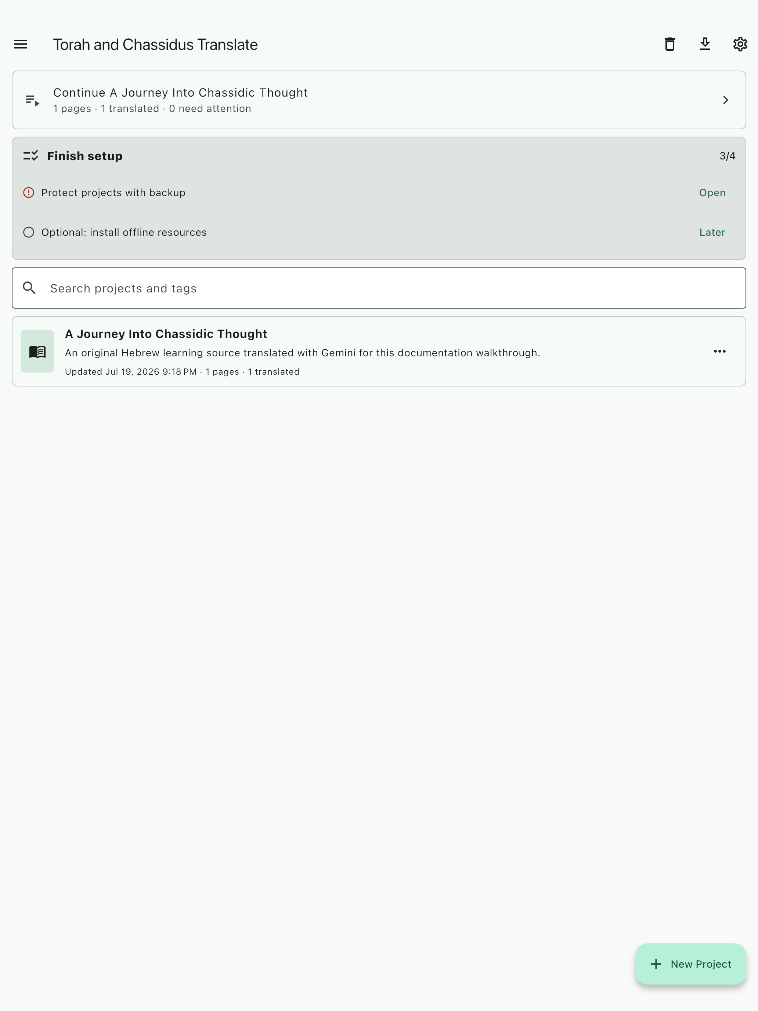
ORGANIZE BEFORE TRANSLATING
A named project preserves context and history
One source, one coherent workspace
Pages, translations, tags, and review items stay together.
The tutor can focus on the project being read.
A named project is easier to export, back up, and return to.
Torah and Chassidus Translate • Authenticated product walkthrough • AI output requires review
04

Slide 5
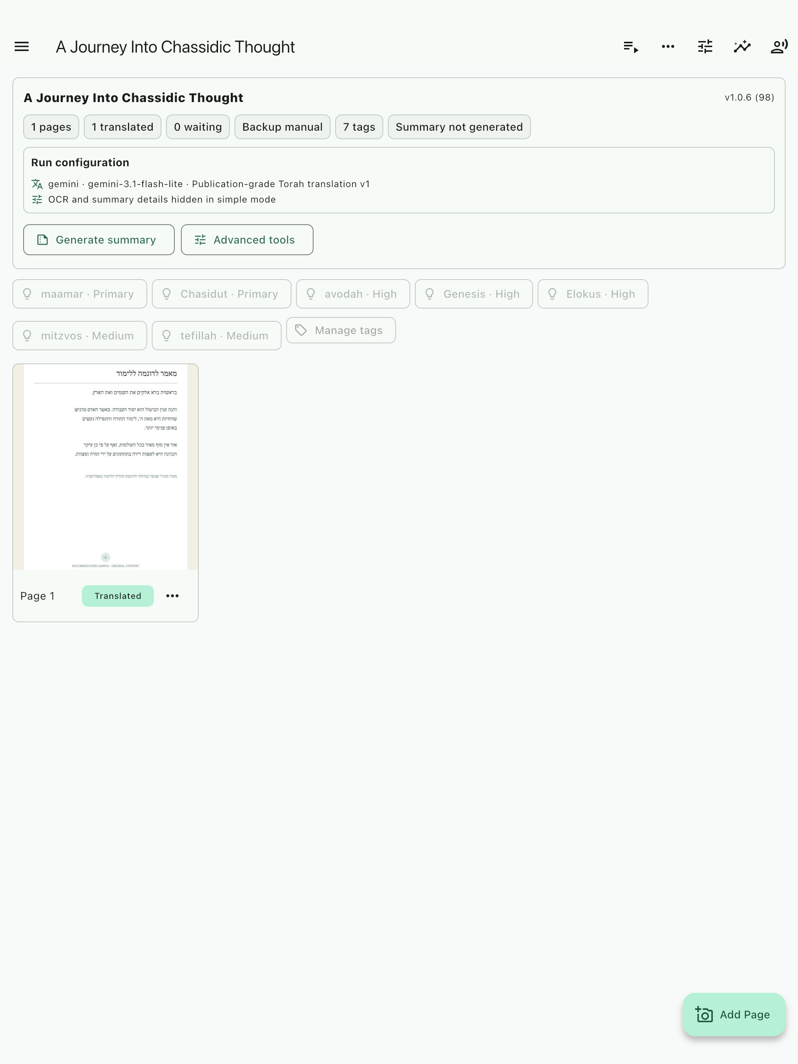
PREPARE ONE PAGE
Verify the image, OCR, and page identity
Three checks prevent expensive mistakes
Image: retain the original and confirm orientation.
OCR: correct source text before it becomes prompt context.
Identity: a standalone number is a printed page unless volume evidence is explicit.
Torah and Chassidus Translate • Authenticated product walkthrough • AI output requires review
05

Slide 6
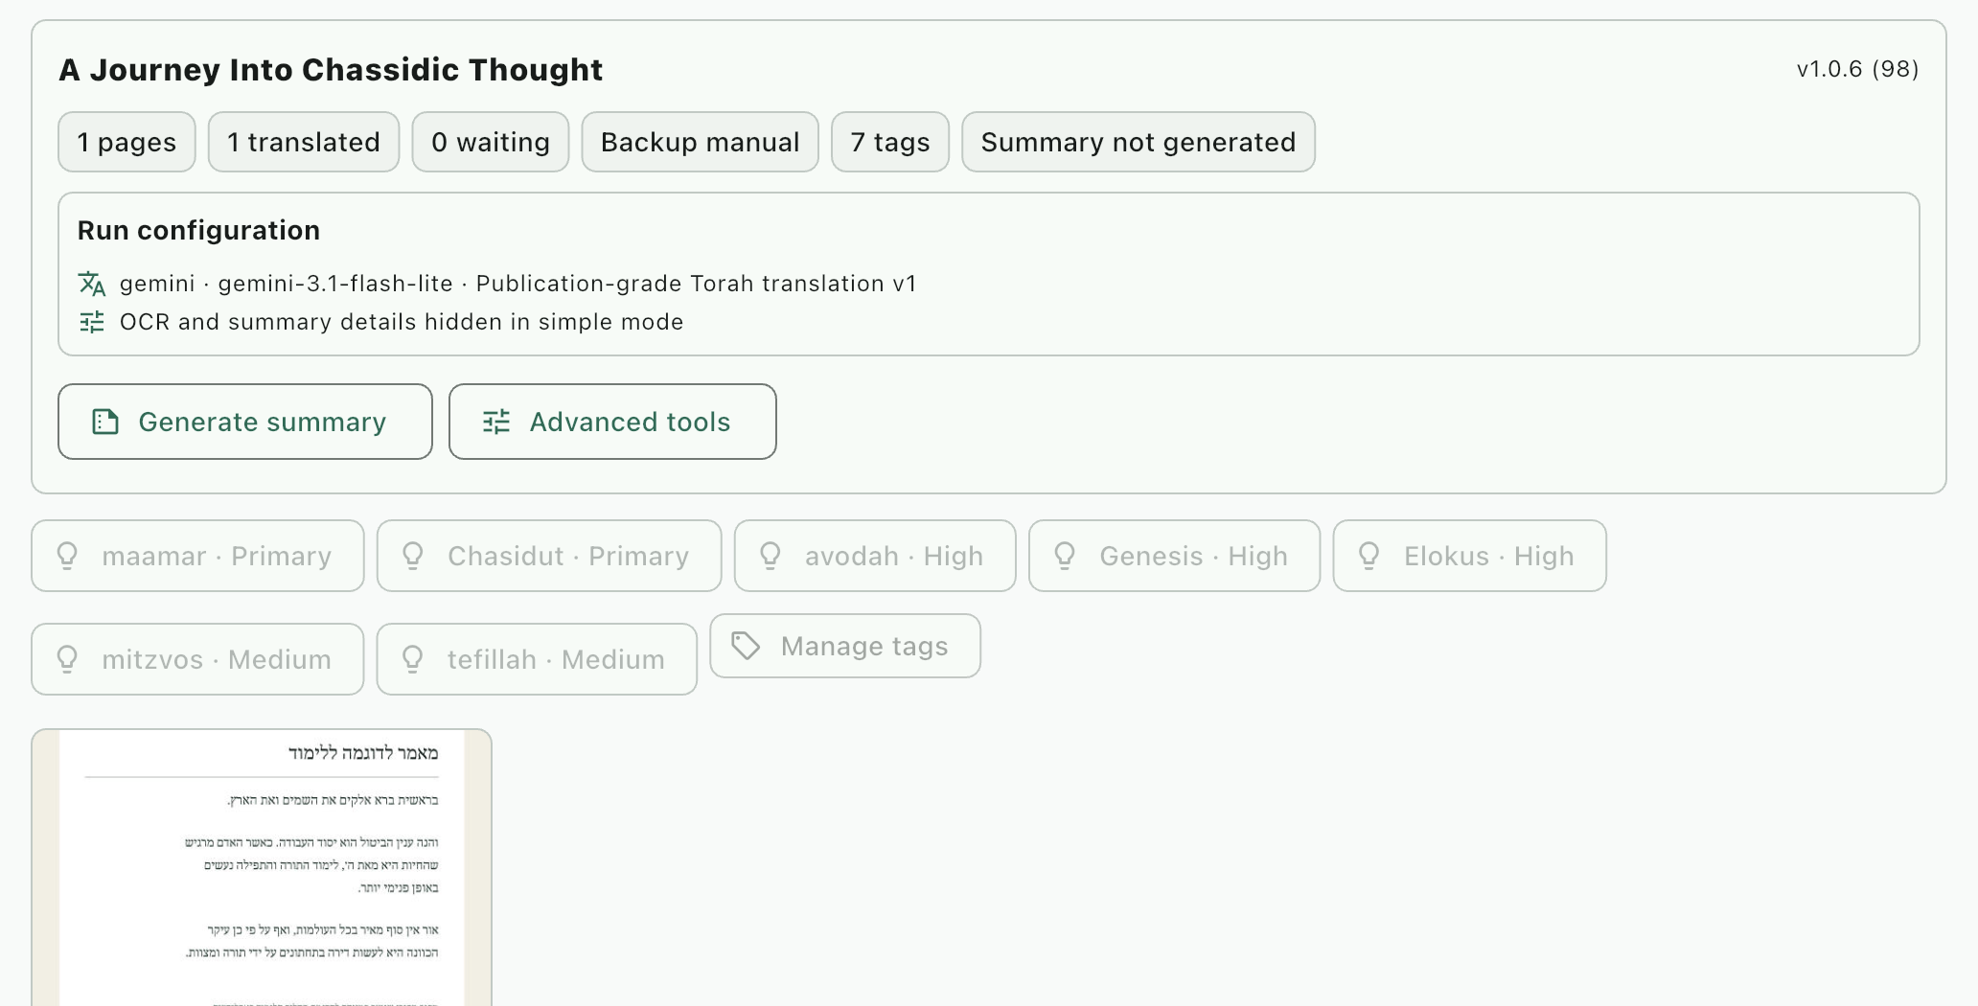
TRANSLATION SETUP
Test one page before committing time and provider cost
Choose the provider, model, template, language, and quality deliberately. A representative test page confirms the workflow before a longer run.
Torah and Chassidus Translate • Authenticated product walkthrough • AI output requires review
06

Slide 7
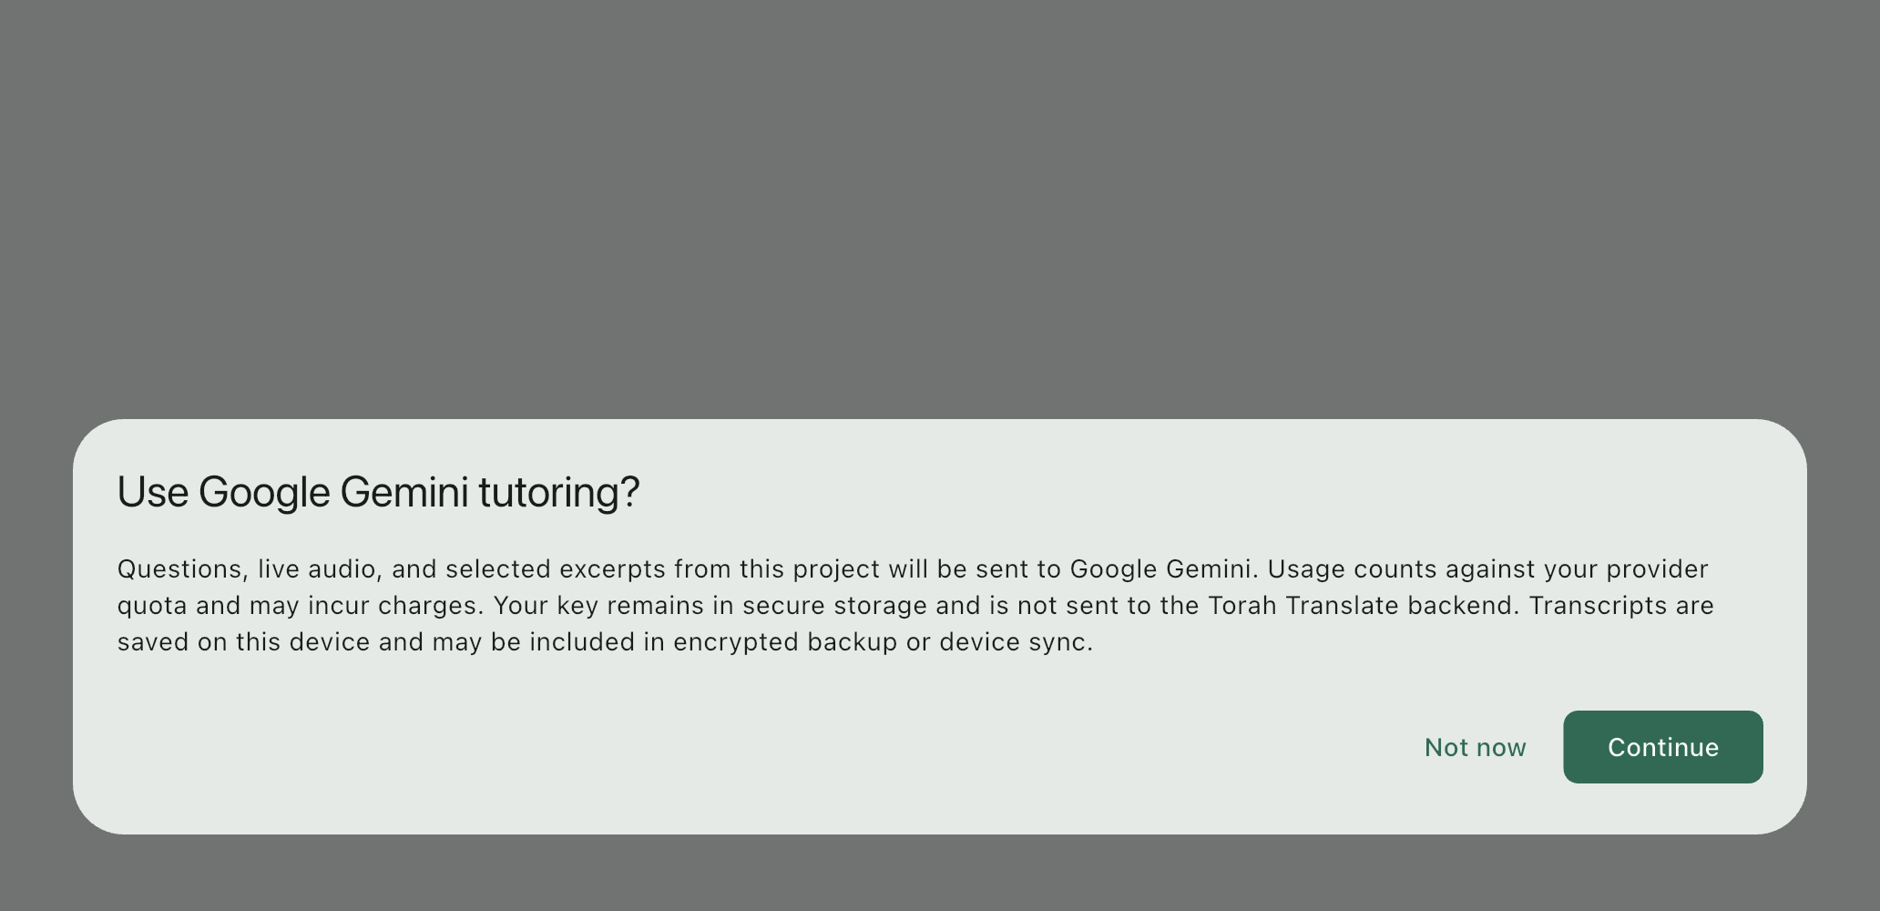
PROJECT-GROUNDED STUDY
Learning continues after the first translation
Ask from the page in front of you
Request a simpler reading. Compare a phrase. Inspect a reference. Save a note. Add a passage to review.
Consent comes before project-grounded cloud tutoring.
See
→
First pass
→
Verify
→
Ask
→
Save
→
Return
Torah and Chassidus Translate • Authenticated product walkthrough • AI output requires review
07

Slide 8
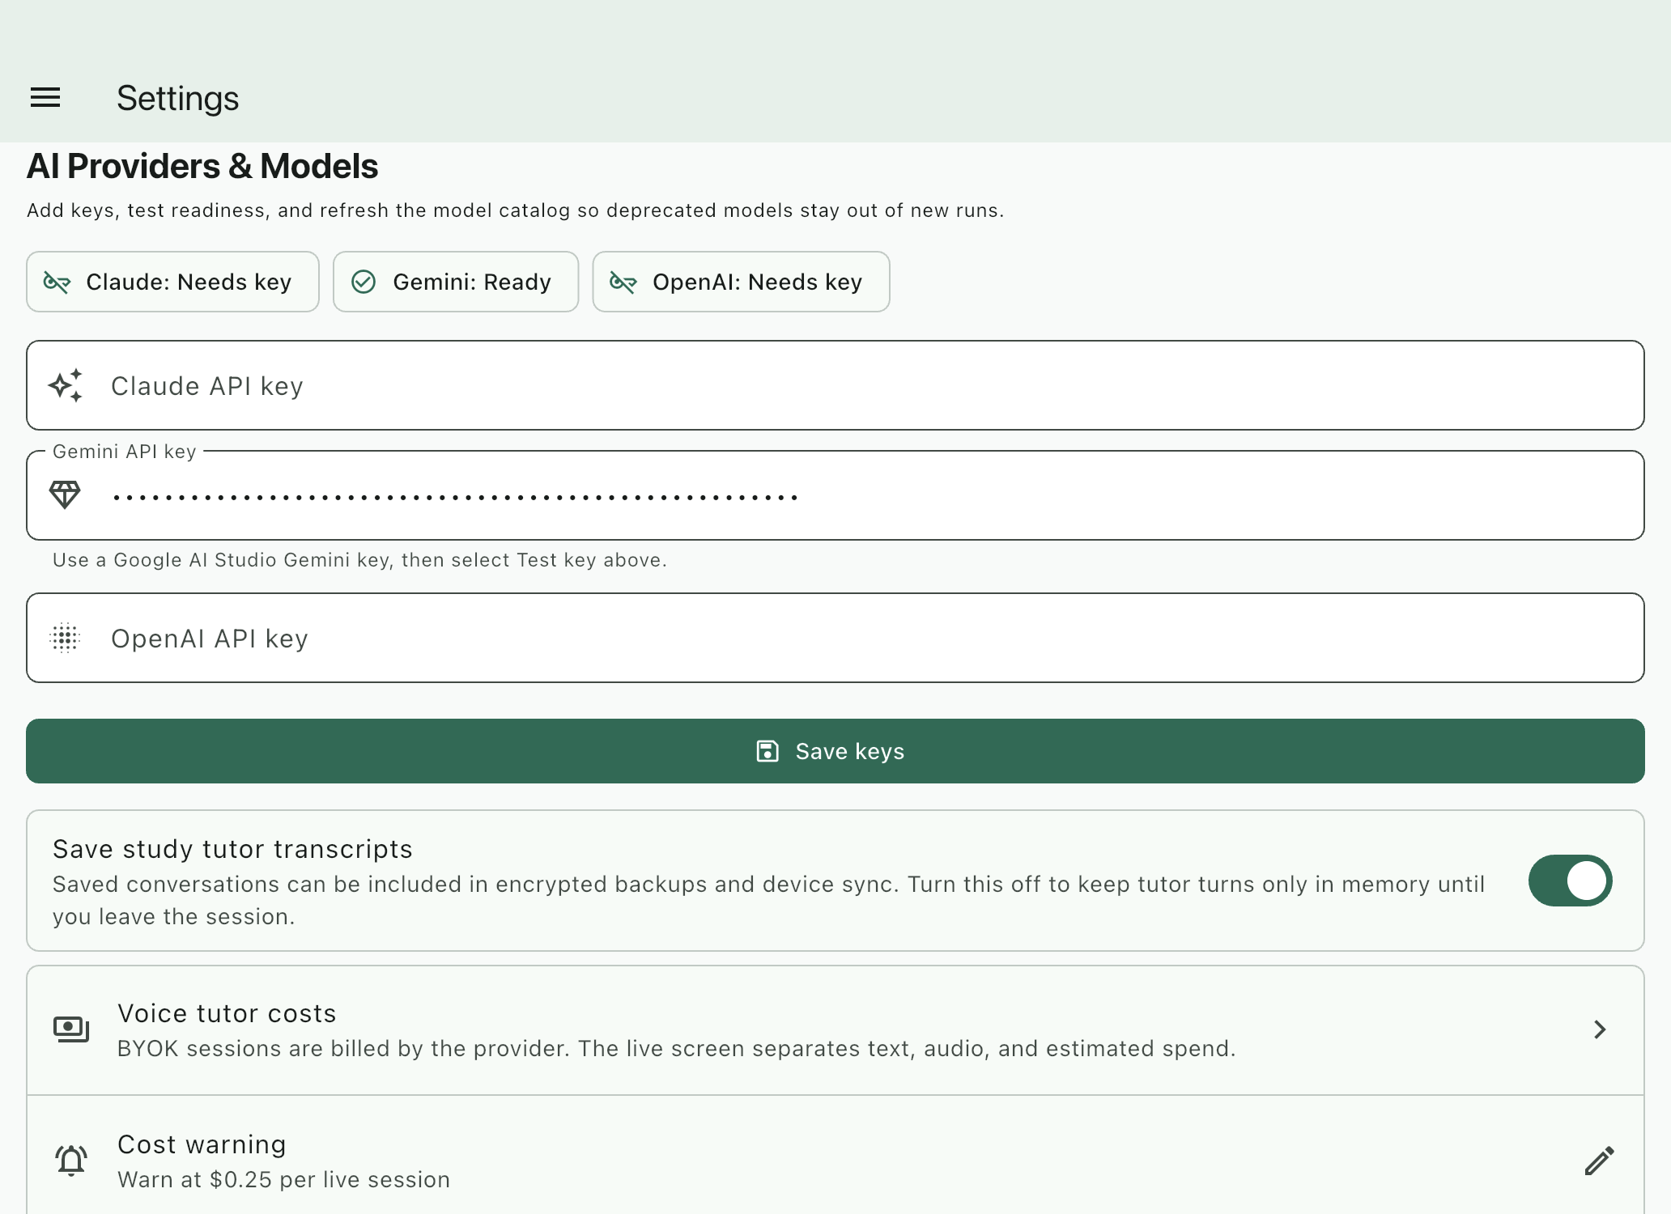
PRIVACY AND COST
Cloud tutoring requires informed consent and visible controls
Credentials use operating-system secure storage.
Cloud requests send required text, images, or audio to the selected provider.
Provider invoices are authoritative; app costs are estimates.
Voice may price text and audio separately; transcript storage is configurable.
Torah and Chassidus Translate • Authenticated product walkthrough • AI output requires review
08

Slide 9
FINISH THE WORKFLOW
Exports and backup make the work portable and durable
Protect the workspace—not only the document
Back up source images, edited OCR, translations, tags, notes, and references.
Reader PDF • Study Reader PDF • Markdown • DOCX • ZIP
Use diagnostics and recovery controls before relying on a restored project.
Content-specific filenames make exported study material recognizable later.
Treat a PDF as a study copy; treat a verified backup as durable project state.
Torah and Chassidus Translate • Authenticated product walkthrough • AI output requires review
09

Slide 10
Make the next question possible.
Create one clearly named project. Import one representative page. Verify it. Translate it. Compare it. Ask one focused question. Save what matters.
torahtranslate.benonionline.com
AI output requires review. Provider charges and terms may apply.

